Slide 1
5 RVIAN *”
COWORKING
Address
C-5, 2nd Floor, Shanti Naga r, Kiran Path, Mansa rova r,
3ai pu r, 3O2O19, Rajasthan
Contact
_{@t} ad m in@a rvian.in
www.virtuaIstategst.com

Slide 2
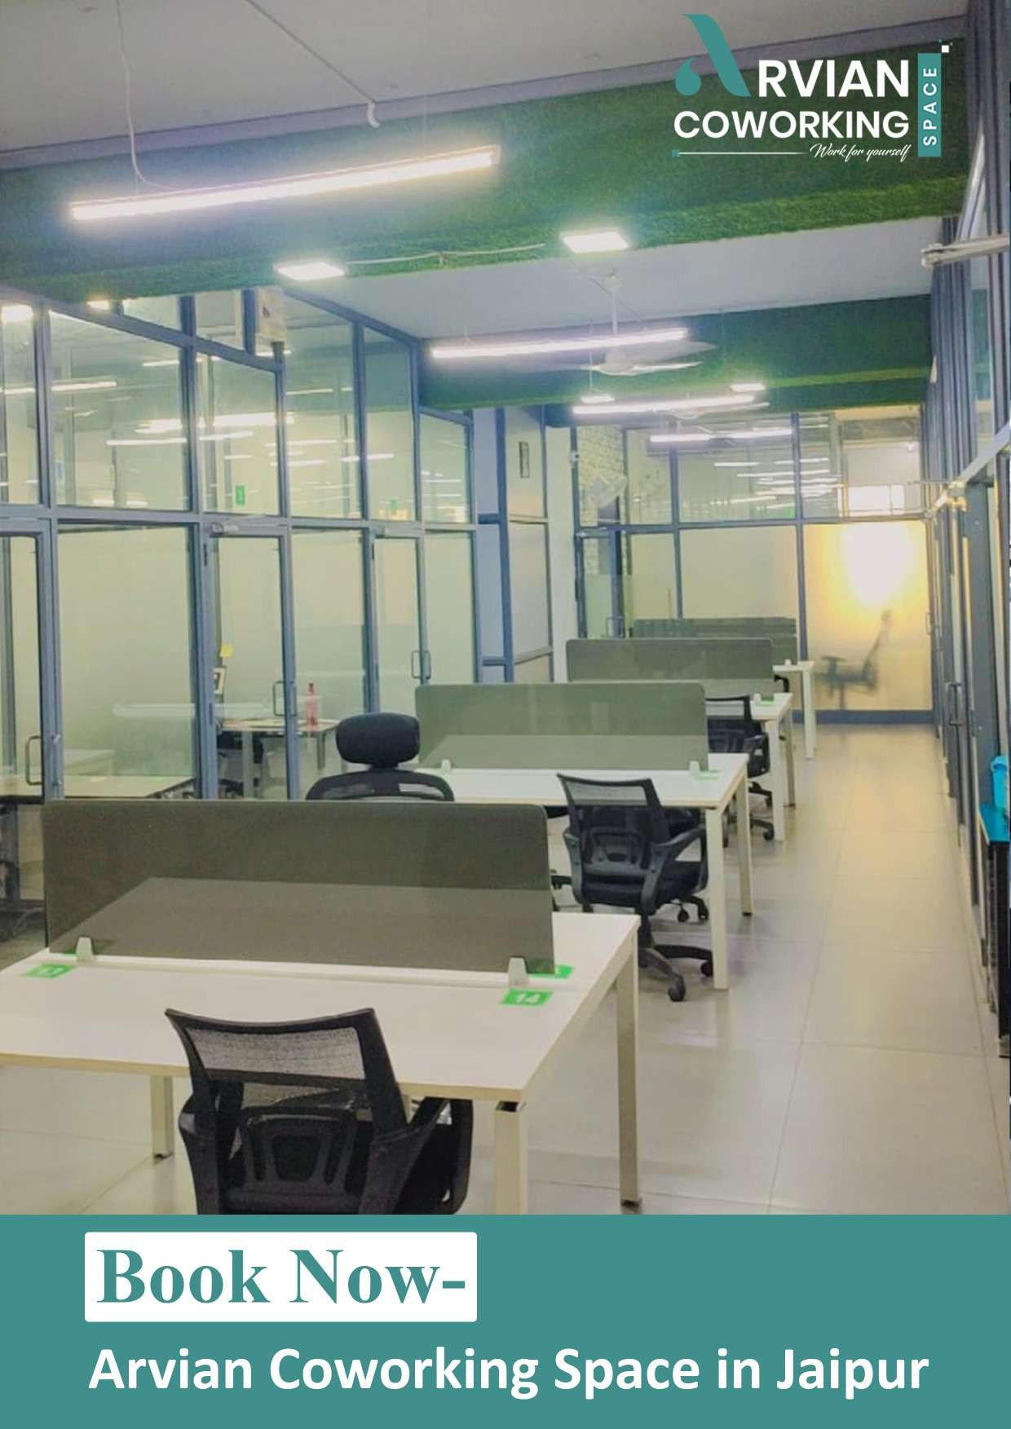

Slide 3
6 RVIAN
COWORKING
‹/r
Who Use Coworking Office?
If you are looking for an office, you can choose a Co-working location instead
of the traditional workspace. From businesses to small businesses to freelancers, office spaces are no longer just traditional workplaces, giving you more choice for Co-working space. People have overtaken boring offices with standard desks and chairs. Co-working spaces have disrupted today's traditional working environment.
Coworking Space Price Plan:
Hot Desk- R3,999/Seat
Choose and work at any desk within the community area.
Dedicated Desk- R4,499/Seat
A fixed desk in a shared coworking space.
Private Cabin- R14,999/Seat (Cabin Capacity 4 seater)
Private office space dedicated to you and your team.
Private Cabin- R21,999/Seat (Cabin Capacity 6 seater)
Private office space dedicated to you and your team.
Private Cabin- R27,999/Seat (Cabin Capacity 8 seater)
Private office space dedicated to you and your team.
Private Cabin- R34,999/Seat (Cabin Capacity 10 seater)
Private office space dedicated to you and your team.

Slide 4
6 RVIAN
COWORKING
Amenities:
WIFI/Internet Printer Reception
Air Condiñoning
Daily House Keeping
•/•
Water BoRIe on Desk Pantry
Super Housekeeping Nearby Food Facilities Hot & Cold RO Water
Meeting Rooms Car / Bike Parking Tea/CoKee lnverterforBatkup
Comfortable Location
The Additional Benefit of Seating Arvian Coworking Space
1 Seat Coworking Space For 11 Months 33,000 +18%Gst
Mail Handling - We provide all Courier and Mail Handling services for a year. Office Assistant - Office Assistant For Representation for 1 Year- For Your
Company.
Bank Account - Bank Account Opening Verification Support With Name
Plate On Wall- For GST / Business Registration cases only.
Address Usage - Address can be used on Visiting cards, Leherheads, Emailers,
Websites, Google Listings, and for all your business Communications For 1 Year.
Professional Address - Use of Professional Address for all your Business
Communication- Emails, Web, Prints, GST registration, and Company Formation.
Customer Support - We provide full customer support for 1 year over E-mail
or Phone.
Bank Details for payment
Name: Arvian Coworking Bank Name: ICICI Bank Account No: 678505601694 IFSC Code: ICIC0006785
Branch Name: JAIPUR TPS MANSAROVAR

Slide 5
NVIAd
;ON%NOMOO
,e

